Slide 1
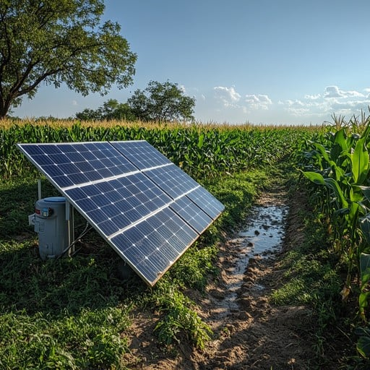
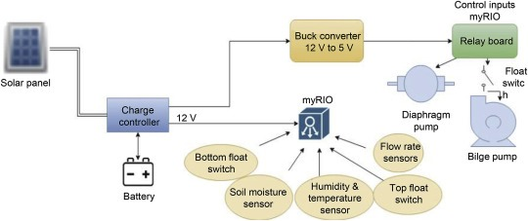
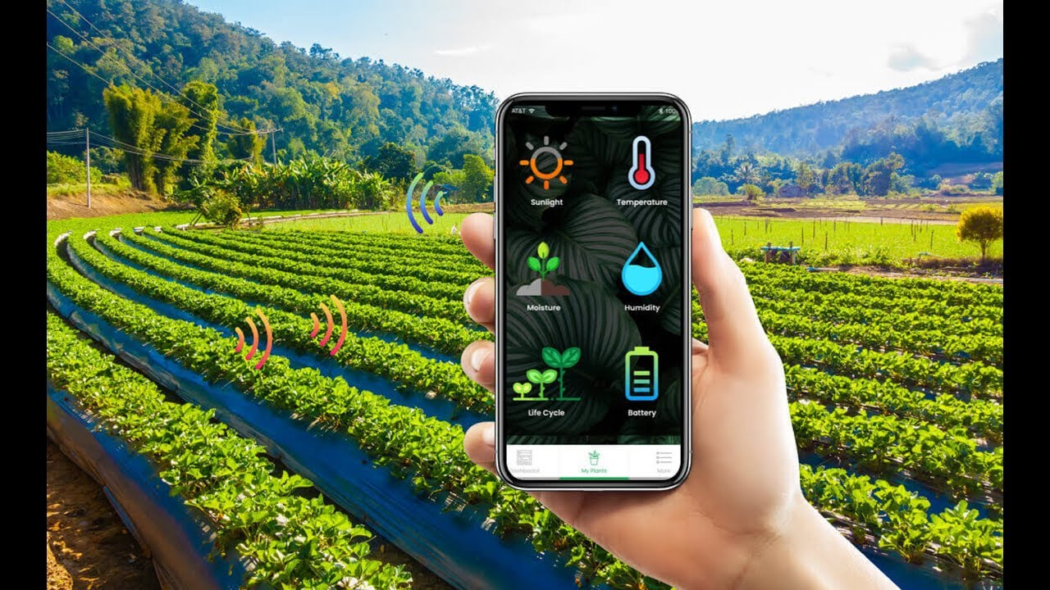
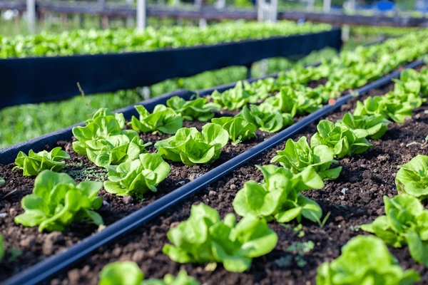
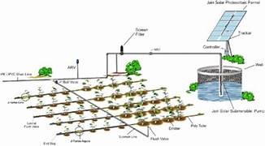
SUSTAINABLE AGRICULTURE WITH SOLAR-POWERED IRRIGATION
PROP0SED SOLUTION
TECHNICAL APPROACH
INTRODUCTION
Utilizes IoT sensors to monitor
soil moisture and environment
-tal conditions.
Uses solar panels for a renewable,
cost-effective energy source.
Provides remote monitoring and
control via a user-friendly interfa
-ce.
Easily adaptable to different farm
sizes and crop types.
IoT Sensors: Monitor soil moisture, temperature, and humidity.
Solar Power: Provides energy using solar panels and battery storage.
Microcontroller (ESP32): Controls irrigation based on sensor data.
Automation: Automatically waters crops as needed to save water and reduce costs.
Communication: Remote monitoring and control via Wi-Fi.
Solar energy is transforming the way
farmers irrigate their crops, offering
an eco-friendly, cost-effective, and
sustainable solution.
These systems work seamlessly
even in remote locations.
With solar irrigation, farms can thrive
with a constant water supply, suppor
-ting healthy crops.
LIMITATIONS
BENEFITS
CONCLUSION
The upfront cost of purchasing and installing solar panels, pumps, and irrigation systems can be high.
Solar-powered systems rely on sunlight, which can be limited during cloudy days or seasons with less sunlight.
Regular cleaning and occasional servicing are necessary to ensure optimal performance.
Reduces labour and operational
costs.
Minimizes waste and maximizes
crop yield.
Uses renewable energy, reducing
carbon footprint
Easily expandable for different
farm sizes and needs. Adaptable
to various crops and environments.
Solar energy-powered irrigation represents
a significant step forward in sustainable
agriculture.
By choosing solar-powered irrigation,
you’re contributing to a greener planet
and ensuring that your farming practice
are aligned with modern sustainability
goals.
.
.

